Slide 1

OnPrintShop A Web2Print solution
A Presentation by
WelTec Web to Print Team

Slide 2
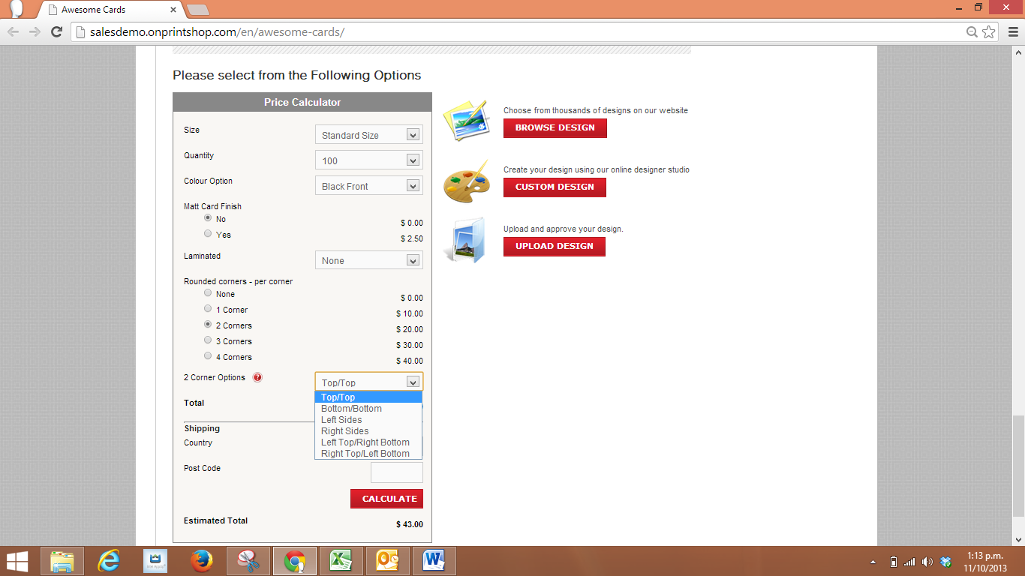
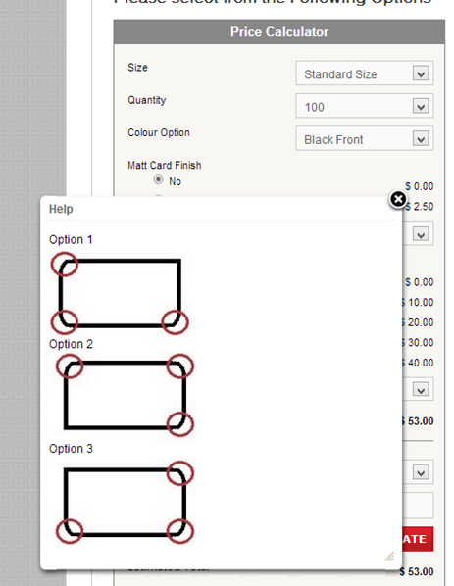
What works well Copy Express’s pricing?
Dynamic Price Calculation for variations with pre- defined amounts.

Slide 3
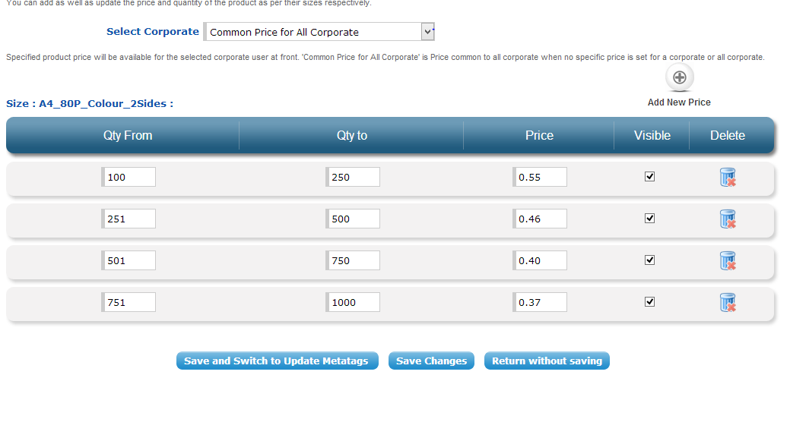
What does not work well Copy Express’s pricing?
multiplication pricing method allows the customer to enter the amount they wish to order but does not give the desired prices.
Quantity Ordered | Price Using the Copy Express Calculator | Price Returned using Ranges entered in the OnPrintShop multiplication pricing method
100 | $82.40 | $55.00
200 | $118.80 | $110.00
250 | $137.00 | $137.50 (Slight error due to rounding)
251 | $137.36 | $115.46
300 | $155.20 | $138.00
400 | $191.60 | $184.00
500 | $228.00 | $230.00(Slight error due to rounding)
750 | $299.00 | $300.00
1000 | $370.00 | $370.00

Slide 4
OnPrintShop Discounting
Easily Create Discount Coupon on the Admin/Orders/Coupon/Discount page.
Can Set To a specific Corporate or all Corporates all Retailers or Specific Retailers.
Coupons can be for one off use, a specific product or multiple use on all products(set by dates).
Can only add one specific retailer at once but can easily duplicate the coupon to allocate to someone else.
The code must be added every time an order is placed but not for every product within the order…i.e. at checkout.

Slide 5
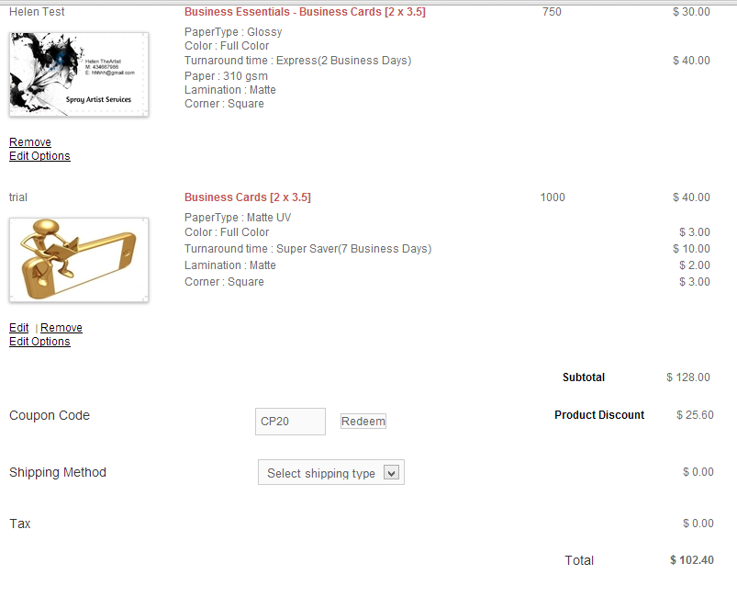
OnPrintShop Discounting

Slide 6
OnPrintShop Order Download
You can download all the orders in one csv/xml file, with selected fields. See Admin/Orders/Export Orders/settings
Or you can download zip file with a separate csv/xml file per order. If there are multiple products per order, all products for the order will be added in single file.
The download name can be formatted as {orders_id}, {user_id}, {order_date}, {order_time}, {order_status}, {random}, {export_date}, {export_time} e.g. For separate file mode orders_{orders_id}_{order_date}_{order_time}
Unpaid orders can be downloaded on their own; see: Admin/Orders/Unpaid Orders/export

Slide 7
OnPrintShop Strengths
Good Price
Established company, over 500 customers worldwide.
Templates supplied
Linked with Fotolia for online image use
Nice customer experience, very good online design studio
Automatically generates the job ticket
Simple “Tick to notify customer” emails
Social Media/Facebook integration
Supports PDFlib files (variable text blocks)
24/7 Customer Support
Quote tracking and approval system
Future development included in monthly fee
Easy to view previous jobs in the “My Portfolio” page, shows image of item ordered.
Good automated online shipping quotation
Overdue orders show up as pink in the list
CSV upload for mail merge type orders

Slide 8
OnPrintShop Weaknesses
No job prioritisation
No automated estimates for offline orders or quotes i.e. you add the total job price in without a breakdown of costs.
No fields to add the paper selection etc. in the job quotes or offline orders
Most recent Jobs at the top of the list rather than the bottom
There is no colour indication that a job is due that day, only when overdue.
Online editor needs flash to run. Doesn’t support phone/tablet.
Users can only upload up to 50mb per file
Cannot change the turnaround time from the admin site if necessary
No Xero API integration
No automated email reminders
Cannot apply non Linear pricing schedule
Cannot apply a customer discount without entering a coupon

Slide 9
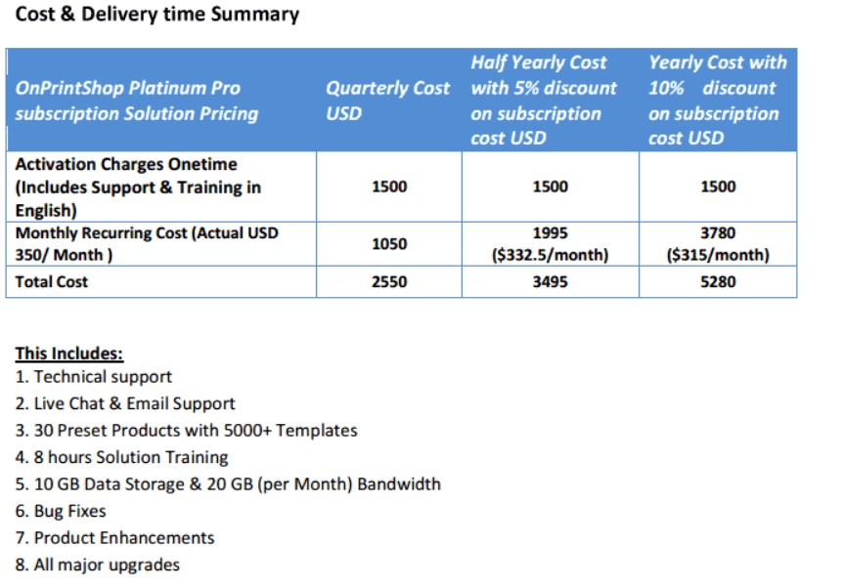
Cost of recommended Platinum Pro package

Slide 10
Additional Costs
Apart from the price mentioned above, they are offering Backend workflow automation as an add on price for $1000US.
The team also enquired about the cost of customisation of the layout of invoice column headers and item separation within orders. OnPrintShop did not give an indication of the price as requested.

Slide 11
Contact Details
Aneesh Wilson, OnPrintShop Consultant, BDE Radixweb, India. Skype: bd14.radixweb Phone Numbers: For Sales - US VoIP: +1-718-715-1551 - Direct Line India: +91-79-32403371 - Office Numbers: +91-79-26400685, +91-79-26404218 ext 232 - International Fax :+1-206-501-3446 Websites: http://www.radixweb.com – Bespoke IT Solutions for Web, Desktop, Mobile and Embedded Systems http://web-design.iipvapi.com – Web & Graphics Designing Services http://www.onprintshop.com – Web2Print Storefront - Powering Your Print Business Online http://www.iipvapi.com – 24x7 Photo Editing Services: Making, Clipping & Retouching

Slide 12
Links to Demos
Storefront URL: http://salesdemo.onprintshop.com/ Retail Client Email ID: aneesh@radix.com Retail Client Password: aneesh Admin URL: http://salesdemo.onprintshop.com/admin/index.php Admin Username: admin Admin Password: demopass1234 OPEN THE CORPORATE URL AND ADMIN IN DIFFERENT BROWSER Corporate URL: http://salesdemo.onprintshop.com/corporate/copyexpress/ Employee Email ID: hema@copyexpress.com Employee Password: hema123 Corporate Admin: http://salesdemo.onprintshop.com/admin/index.php Username: peter Password: peter You can also see our Online Training Video for creating a Product: http://www.onprintshop.com/Online-web2print-training.html

